Slide 1

Multiple Linear Regression
Presented by:
Elizer Ponio Jr.
Department of Computer Science
College of Computing and Information Technologies

Slide 2
Outline
What is Multiple Linear Regression?
Correlation

Slide 3
Multiple Linear Regression
Multiple Linear Regression determines the relationship between a dependent variable or two or more independent variables.
The independent variables can be either continuous or categorical

Slide 4
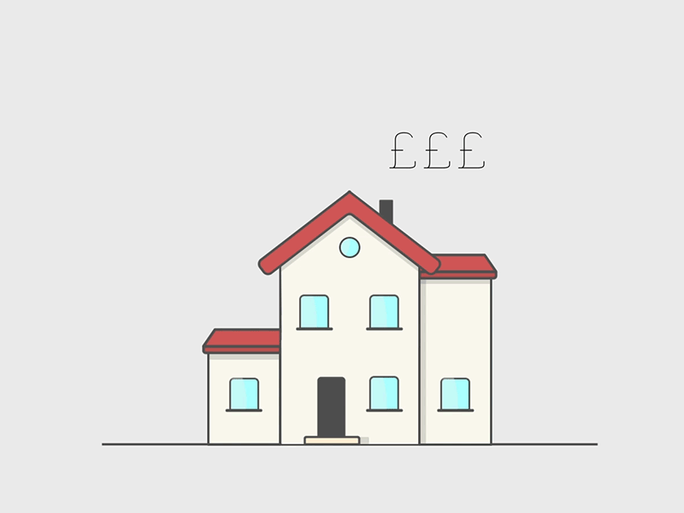




Example: House Price Prediction
Independent Variables
Dependent Variables
Price
Number of Bedrooms
In a mainroad?
Airconditioned?

Slide 5
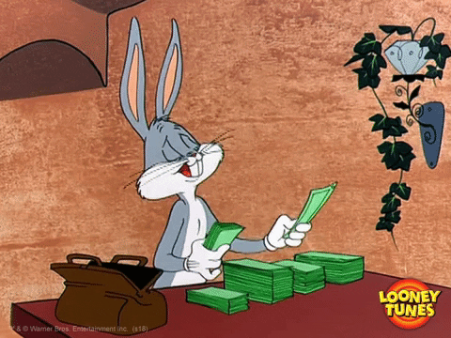



Example: Company Profit Prediction
Independent Variables
Dependent Variables
Profit
Research and Development
Administration
Marketing

Slide 6
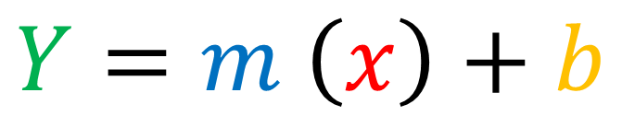
Simple Linear Regression vs Multiple Linear Regression
Simple Linear Regression
$$Y=m \left(x\right)+b$$
Multiple Linear Regression
$$Y=m_{1}(x_{1})+m_{2}(x_{2})+{…+m}_{n}(x_{n})+b$$

Slide 7
Simple Linear Regression vs Multiple Linear Regression
Price of Fuel (X) | Jeepney Fare (Y)
1 | 2
2 | 4
3 | 5
4 | 4
5 | 5
Price of Fuel (X₁) | Price of Water (X₂) | Jeepney Fare (Y)
1 | 5 | 2
2 | 4 | 4
3 | 3 | 5
4 | 2 | 4
5 | 1 | 5
Simple Linear Regression
Multiple Linear Regression

Slide 8

What is Multiple Linear Regression?
Correlation

Slide 9
Correlation
Correlation measures the strength of the relationship between two variables. In other words, it tells you how closely two variables are related.

Slide 10
Correlation
There are two types of correlation:
Positive correlation. This is when two variables move in the same direction. For example, as the price of a stock goes up, the number of shares traded also goes up.
Negative correlation. This is when two variables move in opposite directions. For example, as the price of a stock goes up, the number of shares traded goes down.

Slide 11
Correlation
Correlation is measured on a scale from -1 to +1.
A value of -1 means that the variables are perfectly negatively correlated.
A value of +1 means that the variables are perfectly positively correlated.
A value of 0 means that the variables are not correlated at all.

Slide 12
Correlation
Price of Fuel | Price of Water | Jeepney Fare
1 | 5 | 2
2 | 4 | 4
3 | 3 | 5
4 | 2 | 4
5 | 1 | 5

Slide 13
Correlation
 | Price of Fuel | Price of Water | Jeepney Fare
Price of Fuel | 1 | -1 | 0.77
Price of Water | -1 | 1 | -0.77
Jeepney Fare | 0.77 | -0.77 | 1

Slide 14
Positive Correlation
Price of Fuel | Jeepney Fare
1 | 2
2 | 4
3 | 5
4 | 4
5 | 5
Jeepney Fare (Y)
Price of Fuel

Slide 15
Negative Correlation
Price of Water | Jeepney Fare
5 | 2
4 | 4
3 | 5
2 | 4
1 | 5
Jeepney Fare (Y)
Price of Water

Slide 16
No Correlation
Price of Spare Parts | Price of Lubricant Oil
5 | 2
4 | 4
3 | 5
2 | 4
1 | 5
Price of Lubricant Oil (Y)
Price of Spare Parts

